Slide 1
Monthly Sales Prediction
Prepared by Xiying (Iris) Li
Oct 9, 2020
Prepared by Iris (Xiying) Li
Oct 9, 2020

Slide 2



Approach
Context Gathering & Problem Definition:
Understanding Sales Data
Model Creation & Tuning
Problem: predict sales volume
Data: time-series data showing temporal correlations
Historical trends
Outlier analysis
Data anomalies
Product category analysis
Sales price insights
Model: long short-term memory recurrent neural network
Evaluation: mean squared error
Data-driven actionable business insights to drive sales and predict shop and product performance

Slide 3
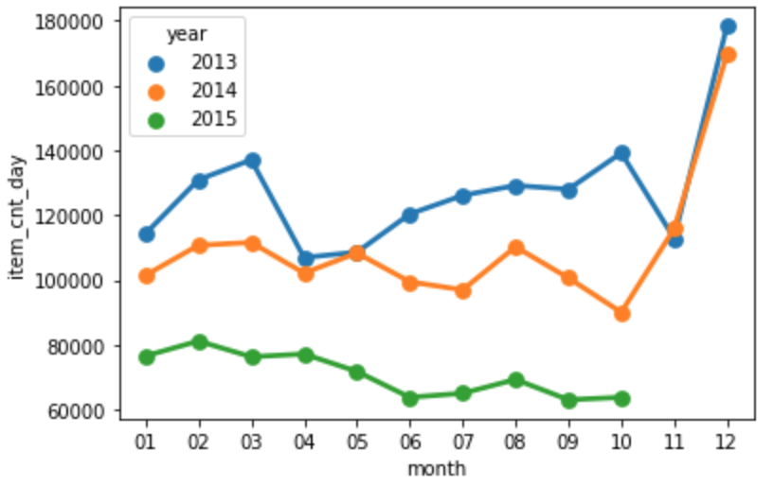
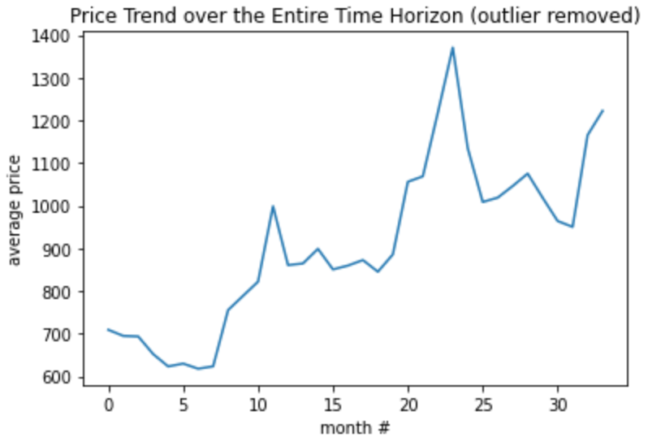
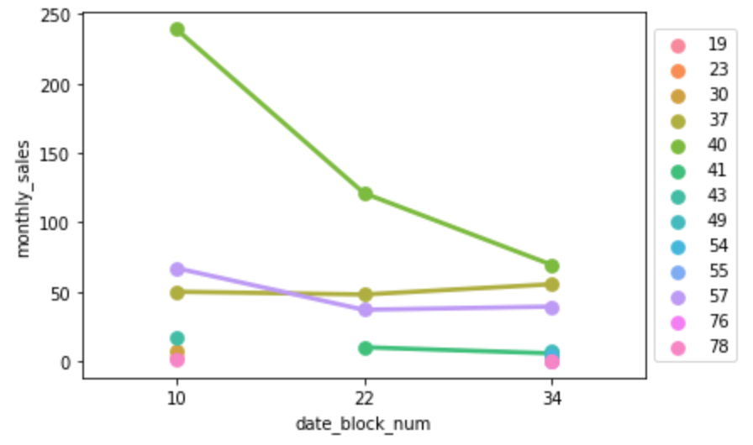
Exploratory Data Analysis
The company is facing a decline in sales volume from 2013 to 2015 across all shops
Possibly because average product prices increased over the past 3 years
Peak in sales typically occurs near year-end, which is holiday season
Sales trends are different across categories, while most showed a decrease in sales, categories such as “Payments cards: Live!, Games PC, etc.” showed higher YoY sales
Monthly Sales Volume by Year
Price Trend over the Entire Time Horizon
Sales in Novembers by Category

Slide 4
Data Cleaning and Transformation
Data cleaning:
Removed rows with negative item prices and/or negative number of items sold in the sales dataset
Sales records Items sold more than 150 per day and/or items price higher than 10,000 were considered as outliers and removed
Test Shop (ID = 0) was removed
The sales data was transformed into a pivot table
Rows: monthly sales of each item in each shop
Columns: month indices, ranging from 0 to 33, corresponding to Jan. 2013 to Oct. 2015

Slide 5
Model Evaluation Metric and Results
Goal: to accurately predict sale volume of each item for every shop in Nov. 2015
Model summary:
Evaluation metric: mean squared error (MSE)
Optimizer: ADAM; batch size: 4096, trained over 10 epoches
After training, the MSE decreased from approx. 3.3 to approx. 2.3, indicating performance improvement
Prediction indicate current business strategy will result in continued decline in sales

Slide 6
Business Implications and Recommendations
Current state analysis:
The company currently is experiencing a decrease in sales
Further analysis shows that this decline is caused by the increase in prices
Model predicts that if no actions are taken, sales will continue to decline
Recommendations:
Consider product pricing changes granular to the category level as predictions showed sales projections to vary across different categories
Consider reducing the price to retain customers
From March to October, have promotions and discounts as these months are off-season
Shops with ID 25, 31, 54 and 55 had significantly better sales over past years. If given more data and time, we can understand the reason and possibly let other shops learn from their strategies

Slide 7
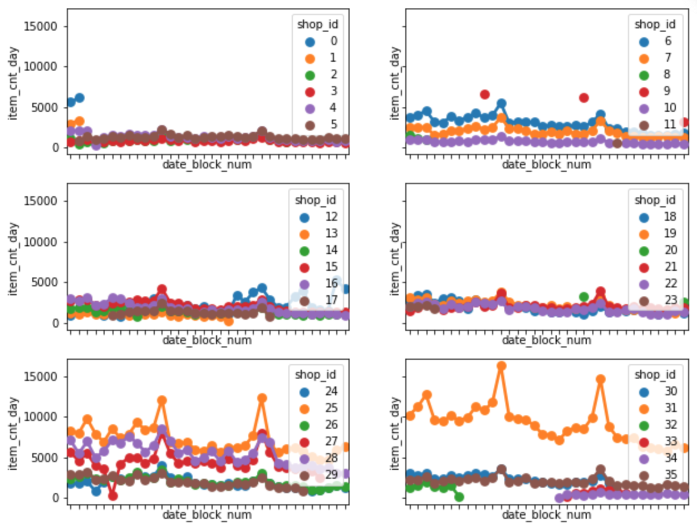
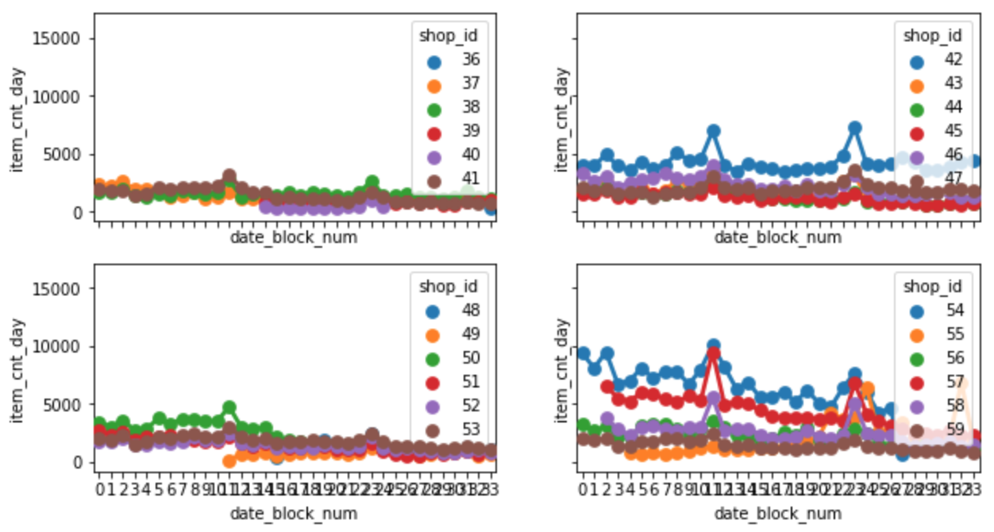
Appendix
Monthly Sales by shop ID over the Entire Time Horizon
Monthly Sales by shop ID over the Entire Time Horizon
Shops with ID 25, 31, 54 and 55 had significantly better sales over past years

